Slide 1
Standard Scores

Slide 2
Comparing Data
Test results for Mary:
Test 1 = 27
Test 2 = 30
Has Mary improved?
Total mark for the tests:
Test 1 = 40
Test 2 = 50
Has Mary improved?

Slide 3
Use mean and standard deviation
Mean for:
Test 1 = 23
Test 2 = 25
Standard deviation for
Test 1 = 5
Test 2 = 10

Slide 4
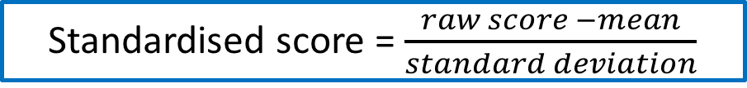
Calculate the standard scores
Also known as standardising the score
The formula is:
Standardised score = $\frac{raw score −mean}{standard deviation}$

Slide 5

So for Mary
Standardised scores:
Test 1 = $\frac{27 −23}{5}$ = 0.8
Test 2 = $\frac{30 −25}{10}$ = 0.5

Slide 6
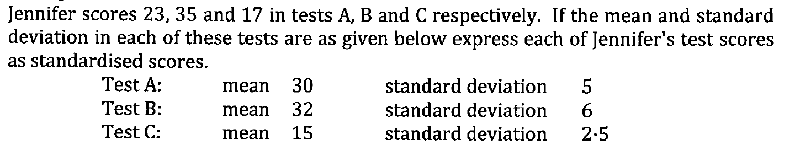

Slide 7
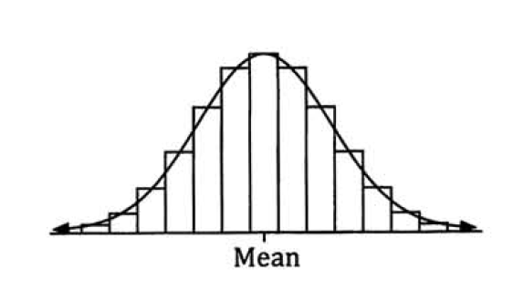
Bell shaped curve
Normal Distribution

Slide 8
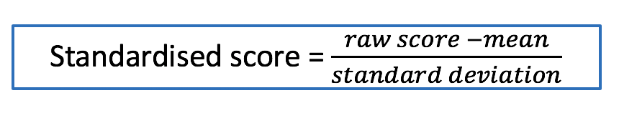
Standard scores is also known as Z-scores

